Slide 1
Math Toolkit
The Support System to Physics

Slide 2
Units of Measure
There are two basic units of measure found in the natural world(read the United States)
US system – based on self indulgent scientists
Metric System – Based on the powers of 10

Slide 3
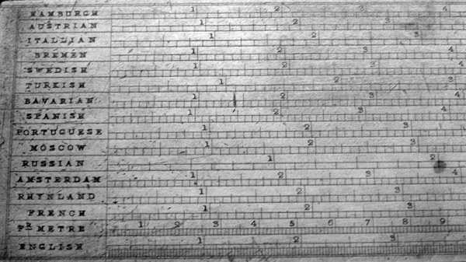
Fundamental Units
Length - m
Time - sec
Mass - kg
cm, mm, km
Astrological units – distance from earth to sun
Light Year – distance traveled by light in a year
Inches, feet (ungainly)
Day, week, hour, year
Pounds, Tons
We will stick with these base units throughout the year.
These three fundamental units L, T, M can be used to derive almost all measurements used in this class.
Notes:
Picture is of a 19th century chart which shows conversions from other measurement systems to the inch

Slide 4
Derived Units
Combinations of the fundamental units to more useful measurements
[Speed]
[Volume]
[Density]
[Acceleration]

Slide 5
Dimensional Analysis
If you drop an ball from a certain height and then change that height what happens to the time?
Notes:
Break down what dimensional analysis means into “their words”
Use notes to guide through mini lab

Slide 6
Error – the forgotten step-child of calculations
Accuracy vs Precision
Accuracy – how well the results agree with the standard value; how close they were to the answer (in true field testing this is impossible to tell since the answer is unknown)
Precision – how exact the measurements were to one another; great precision will look good on paper but without accuracy “I will award you no points and may god have mercy on your soul”

Slide 7
Uncertainty
Any measurement you make is meaningless without the knowledge of its uncertainty
A measure of the amount of error that is made when measuring an event

Slide 8
The SI prefix system
Femto . . . . . . . . . . . . . . . . .
Pico . . . . . . . . . . . . . . . . . . .
Nano . . . . . . . . . . . . . . . . . .
Micro . . . . . . . . . . . . . . . . . .
Milli . . . . . . . . . . . . . . . . . . .
Centi . . . . . . . . . . . . . . . . . .
Deci . . . . . . . . . . . . . . . . . . .
Kilo . . . . . . . . . . . . . . . . . . .
Mega . . . . . . . . . . . . . . . . . .
Giga . . . . . . . . . . . . . . . . . . .
Tera . . . . . . . . . . . . . . . . . . .
10⁻¹⁵
10⁻¹²
10⁻⁹
10⁻⁶
10⁻³
10⁻²
10⁻¹
10³
10⁶
10⁹
10¹²
Notes:
Explain scientific notation and have them practice a couple

Slide 9
Significant Figures
Number of non-zero digits
Number of trapped zeros
Any trailing zeros after the non-zeros with the presence of a decimal
Notes:
Figure 2-4 from book scan in

Slide 10
Sig Figs in Problems
Addition/ Subtraction
Least number of decimal places
Multiplication/Division
Least number of significant figures
Your answer cannot be more precise than the values used to evaluate it
Notes:
Practice one or two

Slide 11
Graphing Data
See Excel Spreadsheet

Slide 12
Types of Relationships
Just Friends
Linear : y=mx+b
Quadratic : y=ax²+bx+c
Inverse: y=a/x
Notes:
Linear is the normal constant rate of change straight line will fit graphed points, quadratic relationship follows a curved path which expands over time, inverse as one goes up the other goes down proportionally

